Slide 1
Dr. SNS RAJALAKSHMI COLLEGE OF ARTS & SCIENCE (Autonomous)
Coimbatore -641049
Accredited by NAAC(Cycle–III) with ‘A+’ Grade
(Recognized by UGC, Approved by AICTE, New Delhi and
Affiliated to Bharathiar University, Coimbatore)
DEPARTMENT OF GRAPHIC AND CREATIVE DESIGN
COURSE NAME : OPERATING SYSTEM (21UCU404)
I YEAR /II SEMESTER
Unit V- Storage management
Topic 1 : Overview of Mass-Storage

Slide 2
Memory
Computer memory is the storage space in the computer, where data is to be processed and instructions required for processing are stored.

Slide 3
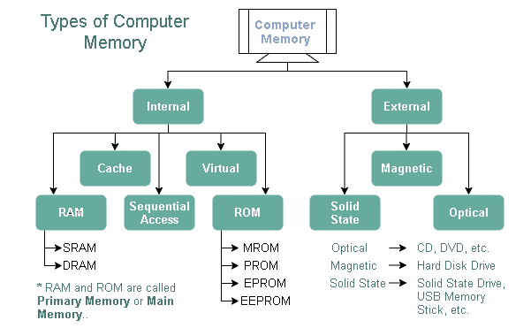
Memory
Primary Memory
Secondary Memory

Slide 4
Primary Memory
A processor or computer initially or directly accesses primary memory while using a computer.
It enables a processor to access programs and services that are now in use and temporarily stored in a particular area of memory.
Primary storage are also called as main memory
The volatile storage component of a computer system is primary memory.

Slide 5
Secondary Memory
Secondary memory is non-volatile, permanent computer memory that is not directly accessible by a computer or processor.
Data that can be quickly and easily retrieved, transmitted, and utilized by apps and services can be stored by the user and then used in this manner.
Read-only memory (ROM), flash drives, hard disk drives (HDD), magnetic tapes, and other forms of internal and external storage media are all considered secondary memory.
Even if the computer is not powered on, data can be stored and retained in secondary memory, which is slower than primary memory.

Slide 6
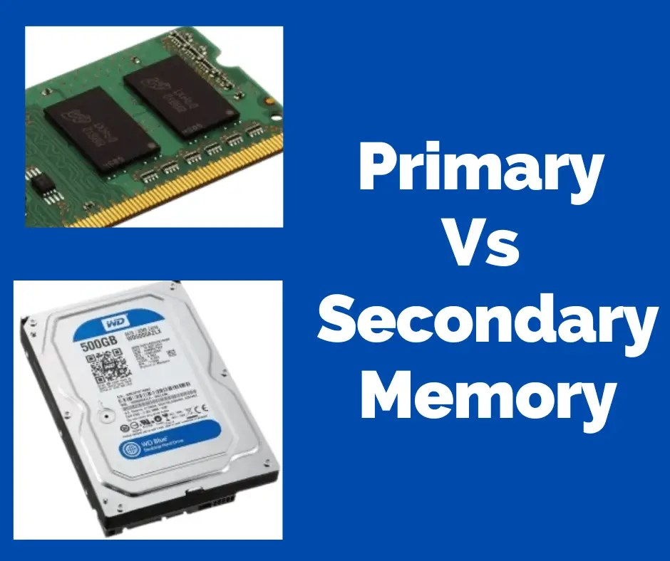
Difference between Primary Memory and Secondary Memory
S. No | Primary Memory | Secondary Memory
1.) | Primary Memory is also primarily known as main memory or primary storage memory | Secondary Memory is also primarily known as secondary memory storage
2.) | They are also known as Internal Memory | They are also known as Auxiliary Memory or Backup Memory or Additional Memory.
3.) | Primary Memory is more costlier than Secondary Memory | Secondary Memory is less costlier than Secondary Memory
4.) | Primary memory is said to be faster than Secondary memory. | Secondary memory is said to be slower than primary memory.

Slide 7
Difference between Primary Memory and Secondary Memory
S. No | Primary Memory | Secondary Memory
5.) | It stores information or data that the processing unit is currently using. Usually, capacity ranges from sixteen Giga Bytes (16 GB) to Thirty Two Giga Bytes (32 GB). | It has a substantial amount of information and data storage. Typically, capacity ranges from 200 GB to terabytes.
6.) | The Primary Memory can be divided as Volatile and Non Volatile Memories | The Secondary Memory can only be classified as Non Volatile Memory only.
7.) | Data cannot be preserved in the event of a power outage since it is a volatile memory. | Because it has a non-volatile memory, the information may be kept even in the event of a power outage.

Slide 8
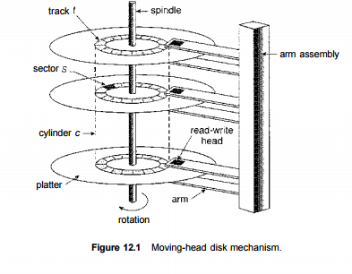
Mass Storage Structure
Systems designed to store enormous volumes of data are referred to as mass storage devices.
Massive storage devices are sometimes used interchangeably with peripheral storage, which is the management of bigger volumes of data that are larger than the native storage capability of a computer or device.
The basic idea of Mass Storage is to create a Data Backup or Data Recovery System.
The Mass Storage Structure Devices are:
Magnetic Disks
Solid State Disks
Magnetic Tapes

Slide 9
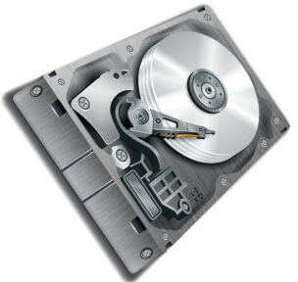
Magnetic Disks
The process of magnetization is used to write, rewrite, and access data on a magnetic disk, a storage device. This process is known as Magnetic Disk.
It is coated magnetically and has tracks, spots, and sectors for storing data.
Basic Common Examples of Magnetic Disks are:
Floppy Disks
Hard Disks
Zip Disks

Slide 10
Structure and Working of Magnetic Disks:
A mechanical arm that travels across a revolving magnetic surface, known as the platter, makes up the majority of a magnetic disk.
They come together to make a "comb." Both reading from and writing to the disk are done using the mechanical arm.
A magnetization process is used to read and write data on magnetic disks.
One or more disk-shaped platters with magnetic material covering them. Unlike "floppy" disks, which are composed of more flexible plastic, hard disk platters are built of stiff metal.
There are two work areas on each plate.
The very top and bottom surfaces of a stack of platters were occasionally avoided by older hard disk drives because they are more prone to damage or even breaking in some cases.

Slide 11
Structure and Working of Magnetic Disks:
The time needed to move the heads from one cylinder to another and for the heads to settle down after the transfer is known as the positioning time, also known as the seek time or random access time.
This is usually the stage that moves slowly and is the main obstacle to high transfer rates.
The time it takes for the requested sector to spin and enter the read-write head is known as the rotational latency.

Slide 12
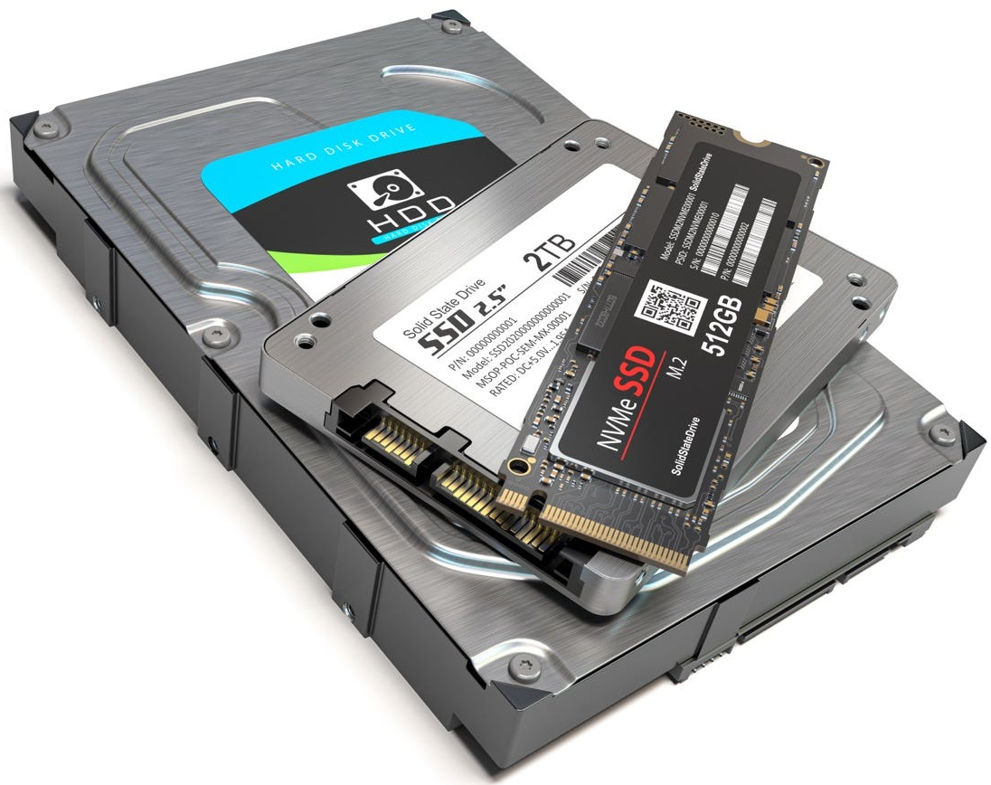
Solid State Disks
SSDs function as a tiny, quick hard disk using memory technology. To maintain the information over power cycles, certain implementations may employ either flash memory or DRAM chips protected by a battery.
Due to the lack of moving components, SSDs operate far more quickly than conventional hard drives, and some issues, such the scheduling of disk accesses, simply do not exist.
SSDs do have certain drawbacks, too, including the fact that they cost more than hard drives, are often smaller, and may have shorter life spans.

Slide 13
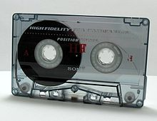
Magnetic Tapes
Prior to the advent of hard disk drives, magnetic tapes were frequently utilized for secondary storage; today, they are mostly used for backups.
It might take a while to get to a specific location on a magnetic tape, but once reading or writing starts, access rates are on par with disk drives.
Tape drive capacities may be anywhere from 20 and 200 GB, and compression can increase that capacity by double.

Slide 14
Thank You

